Slide 1

Essential microservices concepts

Slide 2
What Are We Going To COVER
Why Microservices?
Microservices Architecture
Data in Microservices
The Bounded Context
Logical VS Physical Architecture
Distributed Data Challenges
Identifying Boundaries
The API Gateway
Communication
Containers & Orchestration
Other Considerations
Avoiding Disasters

Slide 3
WHY?

Slide 4
Why?
There are a lot of options for server architectures:
Simple CRUD, single-tier, single-layer
Traditional N-Layered
Domain-Driven Design N-layered
Clean Architecture
Command and Query Responsibility Segregation (CQRS)
Event-Driven Architecture (EDA)
Others…
Microservices!
A huge hype and everybody wants to do them!
Are they really necessary? Are they overly complex?
From my experience – hell no and hell yeah!
Microservices should be thoughtfully considered and researched!

Slide 5
WhY?
Microservices:
Allow distributed applications
Allow independent development
Allow independent testing
Allow independent deployment
Allow independent versioning
These are the best characteristics of a microservice-based architecture
However, there are many drawbacks, especially if we are not careful
Microservices offer great benefits but also raise huge new challenges. Microservice architecture patterns are fundamental pillars when creating a microservice-based application.

Slide 6
WhY?
A lot of companies realize cost efficiency
Introducing containers (not only to microservices) solves
Production problems
Deployment problems
Improves DevOps
Whatever the choice of stacks and technologies!
Docker is becoming the standard for containers
In the future Docker may be part of every data center
Just like the current state of virtual machines

Slide 7
Microservices Architecture

Slide 8
Let’s start with monoliths
Externally, a monolith is an application which
Is deployed as a single process
A single web application, solving all business requirements
A single process
You may use a container to simplify deployment
Internally, a monolith application is separated
Different layers – web layer, domain layer, service layer, etc.
You scale these by replicating them
And adding a load balancer in front of them

Slide 9
Let’s start with monoliths
Benefits:
Simple development
Simple testing
Deployment is easy – single VM or container
Scaling is also easy
Drawbacks:
Huge applications have huge complexity
Slow startup time when the application grows
Each update redeploys everything
Continuous deployment is difficult
Bug in any module – brings down the whole application
Expensive to update dependencies

Slide 10
And move to microservices
Microservice-based application:
Has many applications with different domains, working together
Usually for the back-end, but it is also used for the front-end
Each service runs its own process and communicate to others
Communication is done through HTTP(S), Web Sockets or Advanced Messaging
Each microservice has a context boundary and it is developed autonomously
Each microservice has its own isolated data layer
Size is not important. Internal cohesion and independence are!

Slide 11
And move to microservices
Benefits:
The complexity is decomposed
Different teams work on different services
Deployment may be independent
Each service can be scaled independently
Drawbacks:
Complexity because of the distribution
Database needs eventual consistency and developers must be more careful
Developers need to handle partial failures
Debugging and deployment are more complex
Changes that span multiple services are more difficult to implement
Network starts to be a “thing”

Slide 12
And move to microservices
How to build successful microservices
Monitoring and health checks
Scalable infrastructure – cloud and orchestrators
Security design at multiple levels – communication, authentication, authorization
Rapid application delivery – usually with different teams
DevOps and CI/CD practices
Microservices are challenging and should require careful thinking!
Do not use them as a golden hammer or because of a hype!

Slide 13
Data in Microservices

Slide 14
Data in microservices
Important rules of microservices:
They should own their logic
They should own their data
The conceptual model may differ and that’s OK
Each microservice has its own Bounded Context
In traditional applications we have:
One or multiple databases (or equal)
It looks simpler initially, but the application ends up with huge tables which serve different subsystems
The ACID transactions are a huge advantage of the monoliths
Atomicity, Consistency, Isolation, Durability

Slide 15
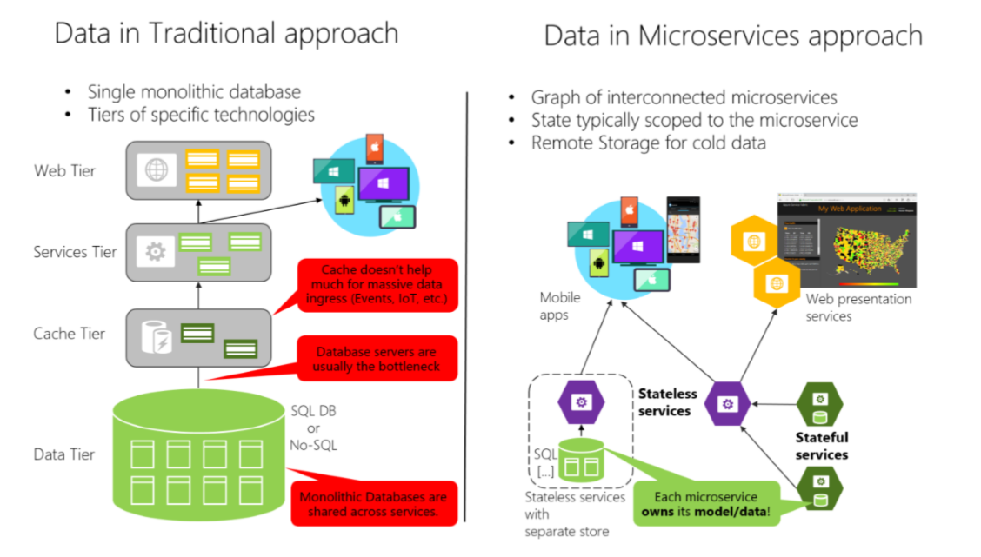
Data in microservices

Slide 16
Data in microservices
Data in microservices is very different
Much more complicated
Data owned by a microservice should be private to that microservice
The only way other microservices can access it are through its
API - REST, gRPC, etc.
Messaging – AMQP
Encapsulating data allows you to have loosely coupled microservices
Which can evolve independently
Consider data schema migrations

Slide 17
Data in microservices
With distributed data structures, you cannot do a single ACID transaction
You need to use eventual consistency
When a business process spans multiple microservices
It is much harder than a normal SQL JOIN
There are no constraints
Most relational database features cannot be fully utilized
This does not mean you must use NoSQL database
It means data management is more complex
Different microservices can use different databases

Slide 18
The BOUNDED CONTEXT

Slide 19
The bounded context
Central pattern in DDD and Microservices
Its focus is dealing with large models by dividing them into logical groups – Bounded Contexts
The logical groups should be very explicit about their relationships
Each Bounded Context has
Unrelated concepts – such as support ticket in a customer support context
Related concepts – products and customers
Different context may have completely different models of common concepts
But may share the same data identity

Slide 20
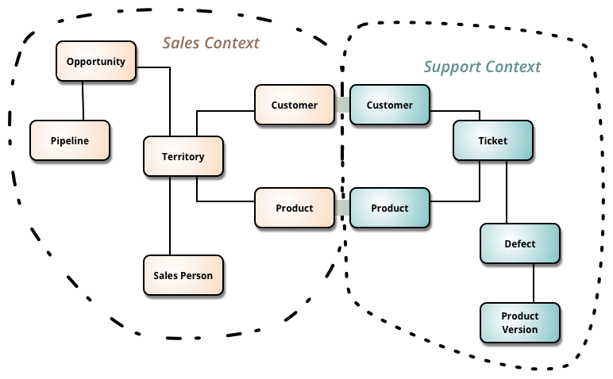
The bounded context

Slide 21
The bounded context
A microservice is like a Bounded Context
A separate process for each Bounded Context
With protocols for communication – HTTP, Web Sockets, or AMQP
Defining a microservice for each Bounded Context in your business domain is a good start
But don’t be constrained by it
Sometimes a Bounded Context have multiple microservices
Just don’t create nanoservices!

Slide 22
Logical VS Physical Architecture

Slide 23
Logical VS Physical Architecture
There is a distinction between the logical and the physical architecture
The logical boundaries of the application do not need to map one-to-one to the physical deployment architecture
If you identity your Bounded Contexts, it does not mean that it is best to implement each one as a microservice
Some Bounded Contexts may need multiple physical servers
As long as your Bounded Context is independently versioned, deployed, and scaled
Most commonly you will have one microservice per Bounded Context but that should not be a strict rule

Slide 24
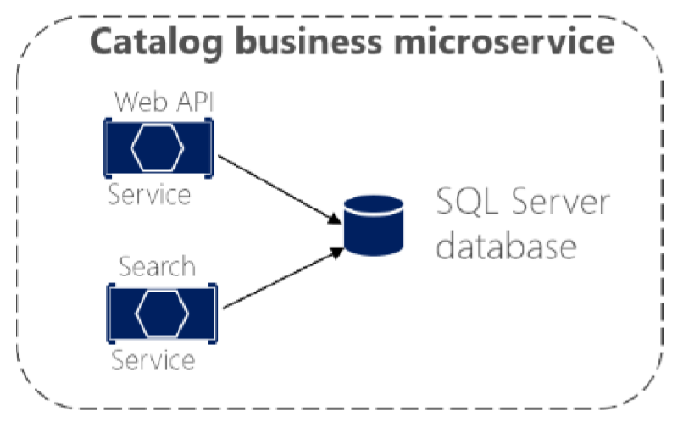
Logical VS Physical Architecture
Consider the following catalog microservice
You may decide to split the internal servers, so that you can scale them better

Slide 25
DISTRIBUTED DATA Challenges

Slide 26
1. HOW TO DEFINE BOUNDARIES
Each microservice should be autonomous, yet part of the whole system
First try to identity “islands” of data and different business contexts
Then try to define the entities in each business context
Some entities may be the same with different names
For example – a user can be user, buyer, and customer at the same time
The main goal is to minimize the coupling between the contexts

Slide 27
2. Query thaT span multiple services
Often, you will need to retrieve data from multiple microservices
While avoiding too much “chitty-chat” between them
Examples:
User information from the Identity, Catalog and Shopping Cart services
Complex report involving many tables across the system
You do not have a simple solution and it depends on the query
API Gateway
CQRS with query/read tables
“Cold Data” in central databases

Slide 28
2. Query than span multiple services
API Gateway – separate microservice for aggregation purposes
Be careful with this one, it may lead to a chokepoint
You can create multiple fine-grained gateways for different “verticals” of the business
CQRS with query/read tables – generate in advance the data in a read-only table
Improves performance, but needs additional work and eventual consistency
You should use event-driven communication to update the tables
“Cold Data” in central databases – extract separate databases
For complex reports with no real-time data
Event-driven communication or database import/export tools
NOTE: If you constantly need data from multiple services that may be a bad design and consider merging microservices into a single entity (remember nanoservices?)

Slide 29
3. Consistency between services
The challenge is to implement end-to-end business processes while keeping consistency across microservices
An example:
Catalog microservice – maintains information about products (including price)
Shopping Cart microservice – maintains current chosen products and price
When a product price is updated – you need to update the cart too (and show a message)
In monolithic application this should be fairly easy
But with microservices – no service should include tables/storage from another one
And it should never call direct queries to them
Solution is event-based communication
Publish-Subscribe pattern

Slide 30
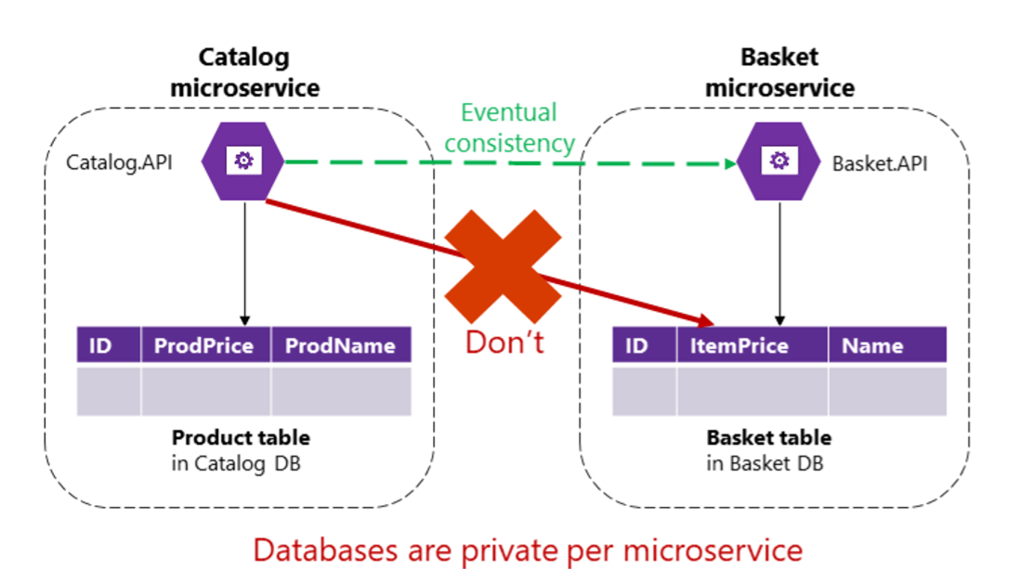
3. Consistency between services

Slide 31
4. Communication between services
The challenge about communication is not so much about the protocols
But more about the style and couplings
Because when failure occurs - the more coupled the system, the bigger issues you will have
Partial failures will happen, so you need to design the system considering the common risks

Slide 32
4. Communication between services
For example – popular approach is HTTP, because it is simple
HTTP is perfectly acceptable, but it depends on how you use it
Acceptable HTTP requests are:
Client-Microservice
Client-API Gateway
API Gateway-Microservice
Unacceptable HTTP requests are:
Microservice-Microservice

Slide 33
4. Communication between services
Consider the following scenario:
The client call the Orders microservice
Then the Orders microservice calls additional microservices for more information
Sounds reasonable at first
But these are the pitfalls:
Blocking and low performance – scalability is impacted
HTTP coupling on a business level – this should not occur
Failure will be difficult to manage – and failures occur
This way – we achieve a monolithic application across many processes
Solution is event-driven asynchronous communication

Slide 34
Identifying boundaries

Slide 35
Identifying boundaries
The goal is not to make as granular microservices as possible
Nanoservices are bad!
The goal is to have the most meaningful separation
Cohesion is the key to separate the microservices
Keep in mind that finding the right “size” is not a one-shot process
The microservices will be continuously evolving
A common way is to split the contexts by the company’s social boundaries
But sometimes it may be the opposite
Duplicated data is completely OK!

Slide 36
Identifying boundaries
Key results for success:
Few strong relationships between contexts
You don’t need to merge information for common processes
If you can work with a microservice without constantly switching to other microservices
Autonomous bounded context

Slide 37
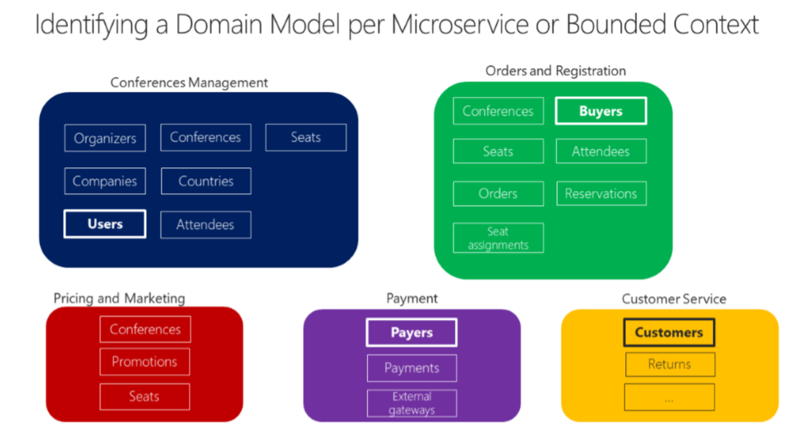
Identifying boundaries

Slide 38
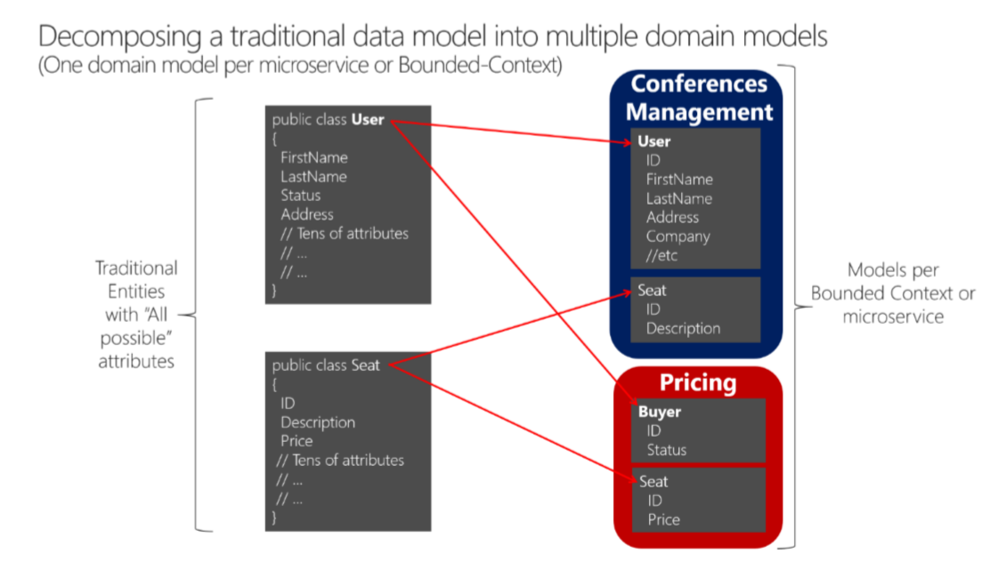
Identifying boundaries

Slide 39
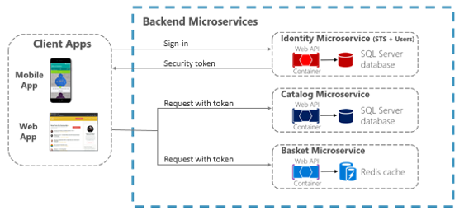
Authentication

Slide 40
Designing the database
Atomic updates, transactions, consistency/referential integrity, and durability are extremely valuable
They should not be waived rashly
Your application must fill the gap with logic when your database technologies cannot guarantee ACID
Requires larger development effort
Clean code & integration testing is key!

Slide 41
Designing the database
Key considerations:
Don't share databases or table ownerships
Duplicate data when needed
Heavy read queries with filtering and paging should be in the same context/database
Don’t be afraid to merge microservices, if the business requirements need it
There is no right or wrong approach if it is solving the domain problem

Slide 42
Designing the database
Breaking relationships:
Depending on the business requirements, it may be better do duplicate data instead of having a fictional foreign key
Start with foreign IDs and evolve accordingly
One-to-one and one-to-many need only an ID reference
Many-to-many relationships may require a separate microservice or a two additional tables

Slide 43
Querying the Services

Slide 44
Querying the Services
Various scenarios:
Direct client-server communication
Server-side rendering
API gateway
Real-time communication

Slide 45
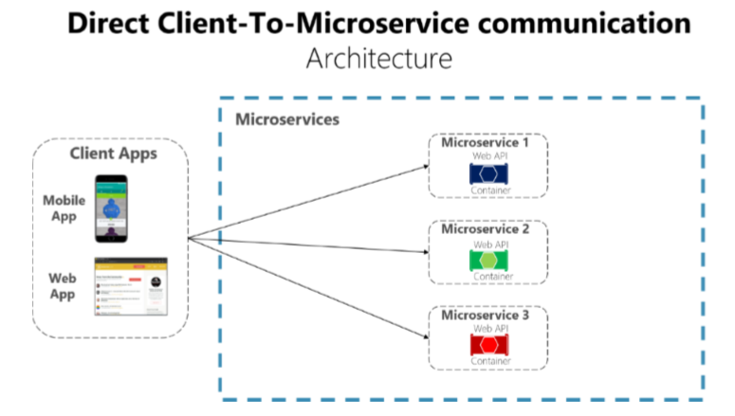
Direct Client-Server Communication

Slide 46
Direct Client-Server Communication
Works great for small applications
Too much web requests, increasing the application latency
Authorization is more difficult to implement
It must be done on every microservice
Handling too many endpoints on the client may become a nightmare
Coupling to many microservices
Cross-cutting concerns such as SSL need to be implemented everywhere

Slide 47
Direct Client-Server Communication
Usually the client calls a load balancer, which requests data from the internal microservice infrastructure
Should be used when
The application is not huge
The data is independent and does not need additional aggregation
Otherwise the client needs to process business logic
Breaking separation of concerns

Slide 48
Direct Client-Server Communication
Drawbacks
Two many Internet round-trips outside of the internal microservice network
Microservices must be exposed to the “external world”
Cross-cutting concerns like authentication and authorization
Using synchronous communication like HTTP
Different client applications require different APIs
Consider web versus mobile clients

Slide 49
Server-Side Rendering
When the client application is not a JavaScript SPA
You can use REST (with Refit) or gRPC
You need to transfer the JWT to a cookie-based authentication
In the production environment, the other microservices can be hidden from the external world

Slide 50
THE API GATEWAY
Provides single-entry endpoint for a group of microservices
Like the Façade design pattern
Also knows as “backend for frontend”
You build it for the specific client needs
Acts as a reverse proxy and man in the middle between the clients and the microservices
Can also provide authentication, cache, and other cross-cutting concerns

Slide 51
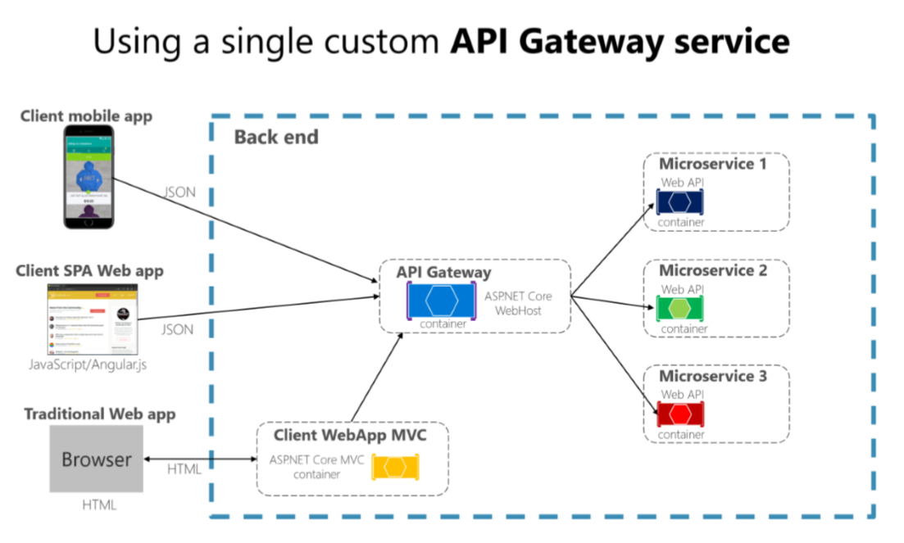
THE API GATEWAY

Slide 52
THE API GATEWAY
If you are not careful, the API gateway may become a full monolithic app
Bloated with too many endpoints
Couples all microservices, destroying their benefits
API Gateways should also be segregated
At first it may be an API Gateway for each client
But then it may be further split by logical groups based on business boundaries

Slide 53
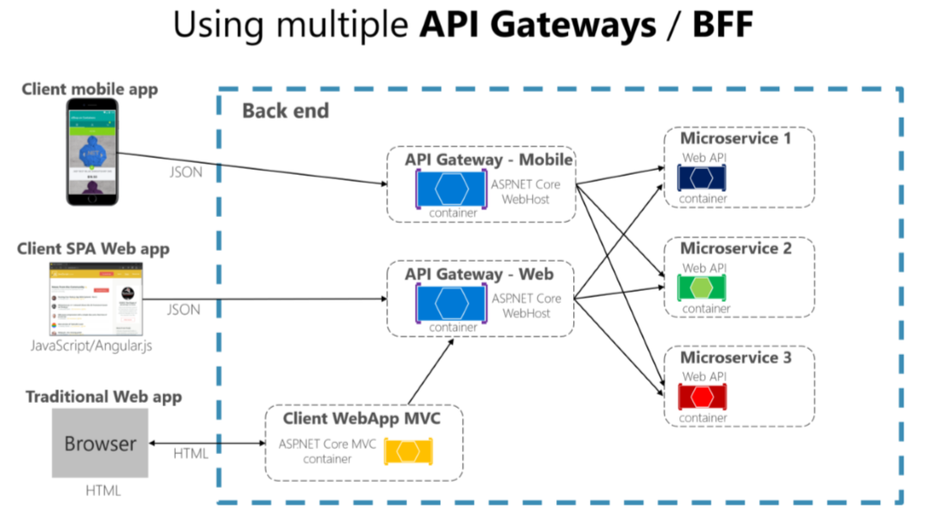
THE API GATEWAY

Slide 54
THE API GATEWAY - Benefits
Reverse proxy and routing
Decouples the client
Modernize legacy monolithic app
Hide the internal microservices
Request aggregation
Reduces chattiness between client and microservices
Especially important for remote applications
Offloading
Authentication, load balancing, retry policies, response caching, IP whitelisting, and more

Slide 55
THE API GATEWAY - Drawbacks
Coupling with the internal microservices
Additional point of failure
Additional network calls
Usually does not have a huge impact considering the alternative
May become bottleneck
Additional development costs and maintenance

Slide 56
Real-Time Communication
Real-time communication can be achieved with HTTP Web Sockets
With fallback mechanisms
It is used when you want to push data to the clients directly
ASP.NET Core has SignalR as a real-time communication technology

Slide 57
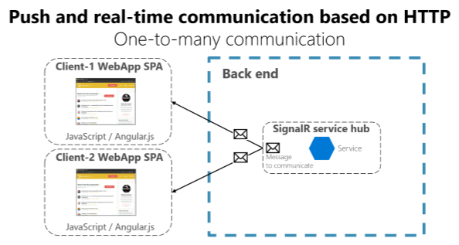
Real-Time Communication

Slide 58
Internal Communication

Slide 59
Communication Types
Sync or Async
Synchronous – HTTP/HTTPS – tasks can continue after the response
Asynchronous – AMQP – the client usually don’t expect a response
Single or Multiple receivers
Single receiver – the Command pattern
Multiple receivers – the Publish/Subscribe pattern
Microservices usually uses a combination of these communication types
If possible, never depend on request-response communication
It breaks the autonomous feature of the microservices
And may turn into a bottleneck
Always consider “the rule of 1 hop”

Slide 60
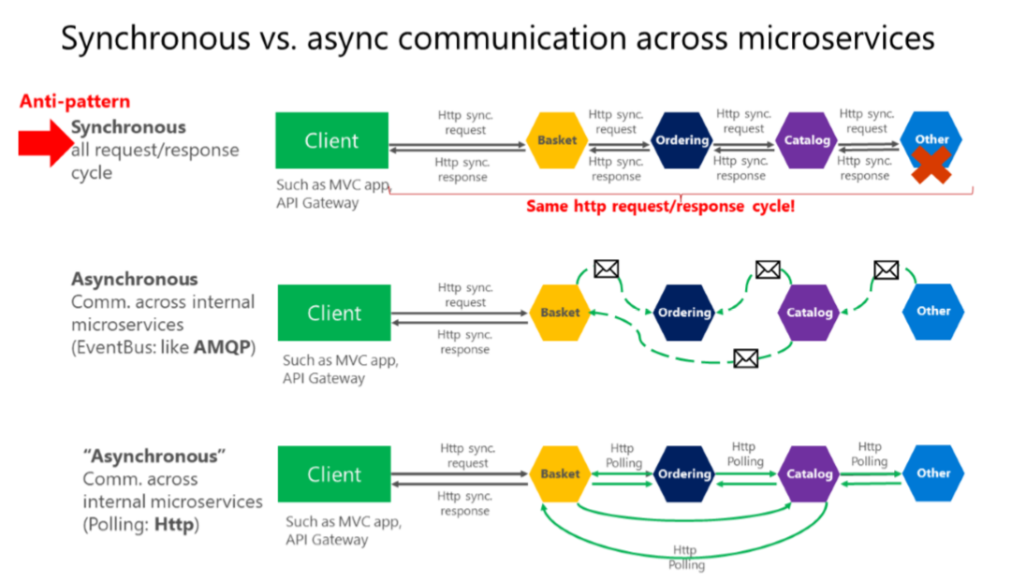
Communication Types

Slide 61
Communication Patterns
Don’t rely on request-response, if possible
If you need data from another microservice, consider duplicating it!
It is perfectly OK!
If your microservice needs to invoke an action in another microservice do it asynchronously
You can use any protocol to transfer data to have eventual consistency
But don’t create synchronous dependencies by waiting for responses

Slide 62
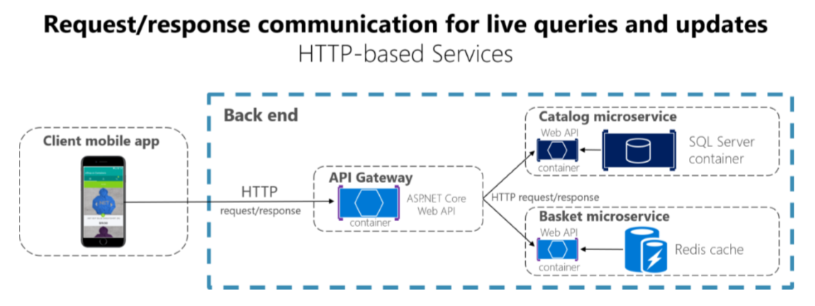
HTTP And REST
Suitable for UI needs and fast responses
Usually useded for queries

Slide 63
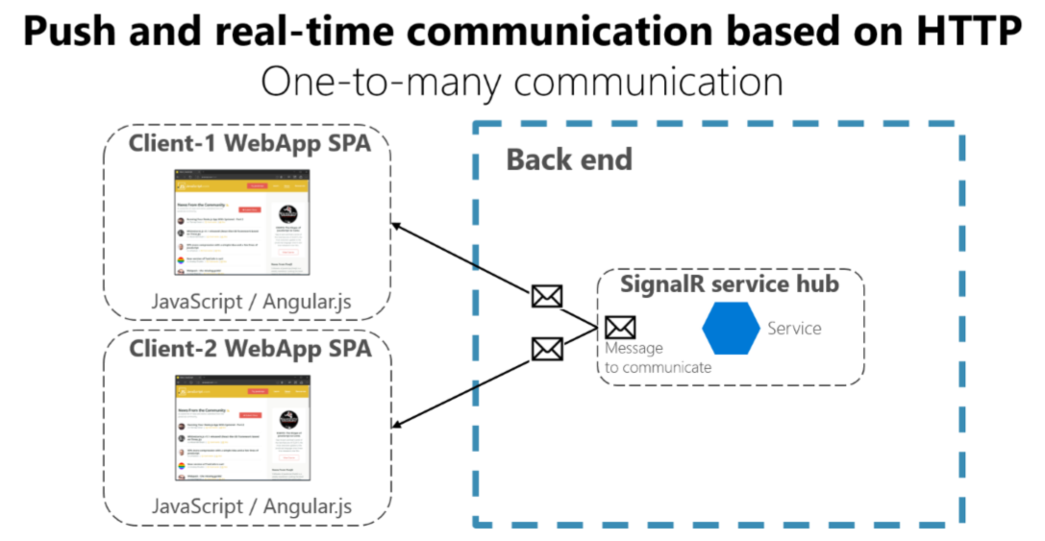
Web sockets
Suitable for real-time UI data

Slide 64
Asynchronous messages
Critical for propagating changes throughout multiple services
Eventual consistency + event-driven communication
A client send a message (header and body) and do not expect a response
If the service needs to return a response – it sends another message
Usually sent asynchronously through AMQP
The preferred infrastructure is a lightweight message broker
Like RabbitMQ or a cloud-ready service bus
Rule is:
Use HTTP for client + API Gateway + First microservice level (Frontend microservices)
Use AMQP for service level (Backend microservices)

Slide 65
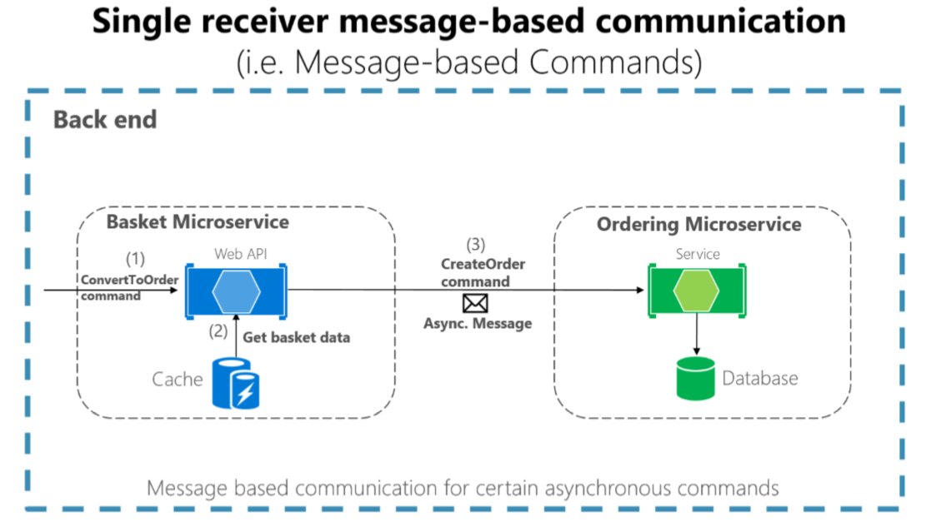
Single receiver

Slide 66
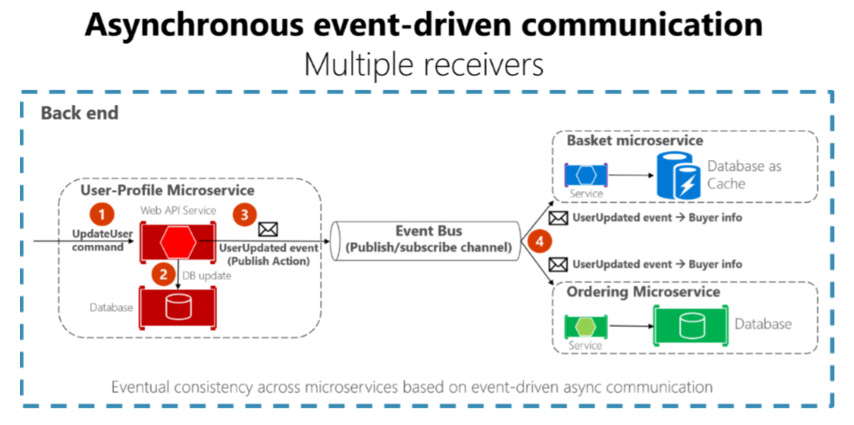
Multiple receivers

Slide 67
Asynchronous messages - Problems
The operation is not atomic
What will happen, if network fails?
Possible solutions:
Transaction log mining
Creates coupling to the database
The Event Sourcing pattern
The full pattern requires serious rearchitecting
The Outbox pattern
A separate table, holding the events, part of the transaction

Slide 68
Asynchronous messages – atomicity
Create an additional table holding the integration events between microservices
Before publishing to the event bus – create a local database transaction
Updating the entity and saving the event as “pending”
Publish the event for the other microservices
If the publishing is successful – mark the event as “completed” with a new transaction
Have a background job to check periodically for failed “pending” events and publish them to the event bus
Guarantees you eventual consistency
Make sure you save yourself from database failures too!

Slide 69
Asynchronous messages – atomicity
The receiver microservice should do one of the following
Make sure the operations can be performed multiple times without affecting the result
Recognize duplicated messages and discard them
Idempotent messages:
Should be like “set the price to $40.00”
And not like “add $5.00 to the price”
Recognizing events can be done by adding a GUID to every event
Or use the infrastructure’s built-in features

Slide 70
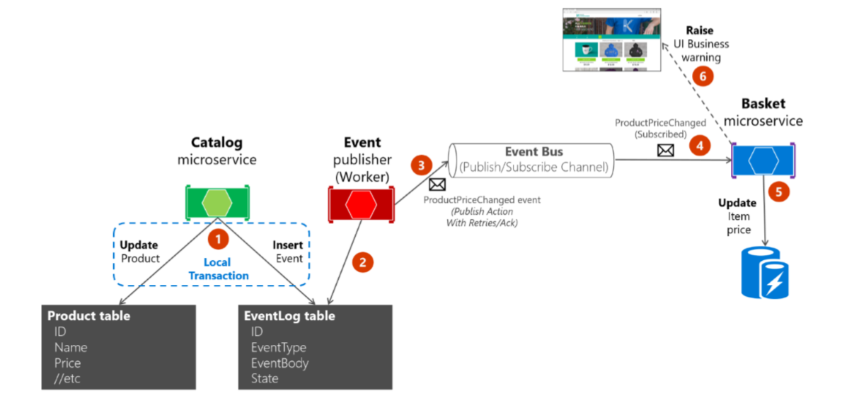
Asynchronous messages – atomicity

Slide 71
OTHER Considerations

Slide 72
VERSIONING
Each microservice represents a public contract
It is important to deployed changed public URLs as new versions
While the old URLs are still working
You can’t force all clients to redeploy and update right away

Slide 73
addressability
Each microservice should have a unique name
And it should be discoverable no matter the infrastructure below them
You should use a service registry
A highly available and up-to-date database
Containing network locations of service instances
Most clusters already have a service registry included

Slide 74
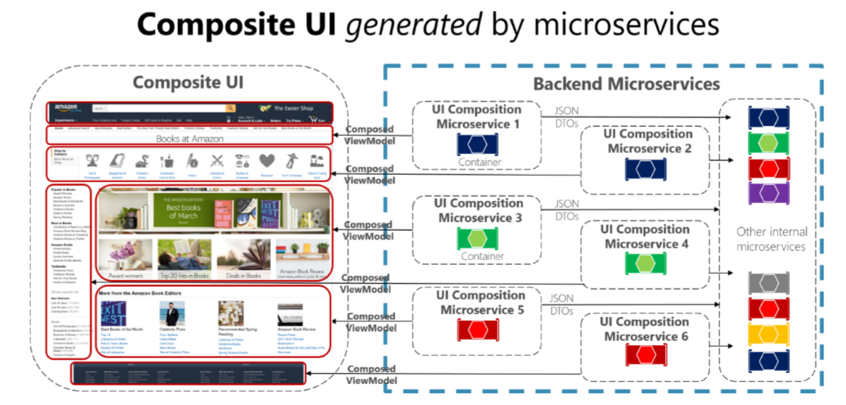
UI Based on Microservices

Slide 75
HEALTH
Often overlooked, but each microservice should report health
Periodic checks for:
CPU power and RAM usage
Availability for web requests
Dependencies are working correctly
Log information:
Each event and action from the microservice should be logged

Slide 76
Avoiding Disasters

Slide 77
Avoiding Disasters
Don’t go polyglot
Using multiple technology stacks makes you reinvent the wheel multiple times
Don’t share databases or table ownerships
Imagine schema migrations and their consequences
Be careful with event logic code
Don’t copy paste code, extract to common classes
But be careful with common classes and logic
Microservices may depend on your changes
Don’t handcraft, use CI/CD
In a such complex solution, many things may go wrong

Slide 78
Avoiding Disasters
Don’t assume the network is reliable and fast
Make sure you have error handling and asynchronous communication
Write tests
For real, write tests – unit, integration, you name it…
Don’t create a SPA monolith
Separate the UI layer to API Gateway microservices
Involve the business in your overall architecture
The domain contexts should be well-defined in the organization
More information in this lecture (you will laugh hard):
https://www.youtube.com/watch?v=X0tjziAQfNQ

Slide 79
CONTAINERS

Slide 80
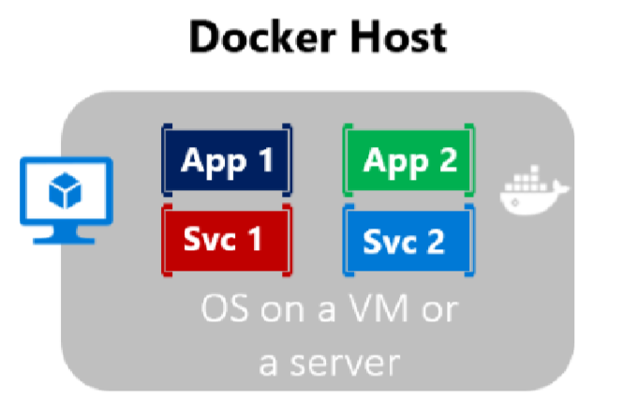
Containerization
Approach in which an application or service is packaged as an image
With its dependencies and configuration
The containerized application can be tested and deployed as a unit to the host OS
Allows deployments across environments with little or no modification
Containers also isolate applications from each other on a shared OS
The containers runs on a container host
The container host runs on an OS (Linux or Windows)
Thus having a smaller footprint than virtual machines

Slide 81
DOCKER
Open-source solutions for containers
https://github.com/moby/moby
Its containers can run anywhere
They run natively on Linux or Windows and are cloud-ready
However, Windows container can run only on Windows so choose carefully
To get started, go to:
https://www.docker.com/get-started
And download Docker Desktop
You may try the playground too:
https://www.docker.com/play-with-docker

Slide 82
Containers VS Virtual MACHINES
Virtual machines include:
The application
The binaries
A full guest operation system
Containers include:
The application
The binaries
But they share the OS kernel and run in isolated processes
Containers use less resources, they are smaller
So they easier to deploy
And start fast

Slide 83
Docker Terminology
Container image
Package with all the dependencies and information needed to create a container
Includes all dependencies + deployment and execution configuration
Images are immutable once they are created
Dockerfile
A text file, which contains instructions for how to build an image
Build
An action of building an image based on the Dockerfile configuration
Use the docker build command

Slide 84
Docker Terminology
Container
An instance of the image
Represents the execution of a single application, process, or service
Volume
A writable file system, allowing containers to persist state
Repository
A collection of related Docker images
Registry
A service, which provides repositories
Default is Docker Hub

Slide 85
Docker Terminology
Compose
A tool for defining multi-container applications
Uses YML
Cluster
A collection of Docker hosts
Exposed as single Docker host
Allows scalability
Orchestrator
A tool which simplifies management of clusters and Docker hosts
Responsible for running, distributing, and scaling workloads across nodes

Slide 86
Development process
Developers create an application
The application is packaged with its dependencies as an image
The image is instantiated to create a container
Containers are initially tested on the development machine’s Docker host
Developers store images in a registry
These images are used by the production orchestrators

Slide 87
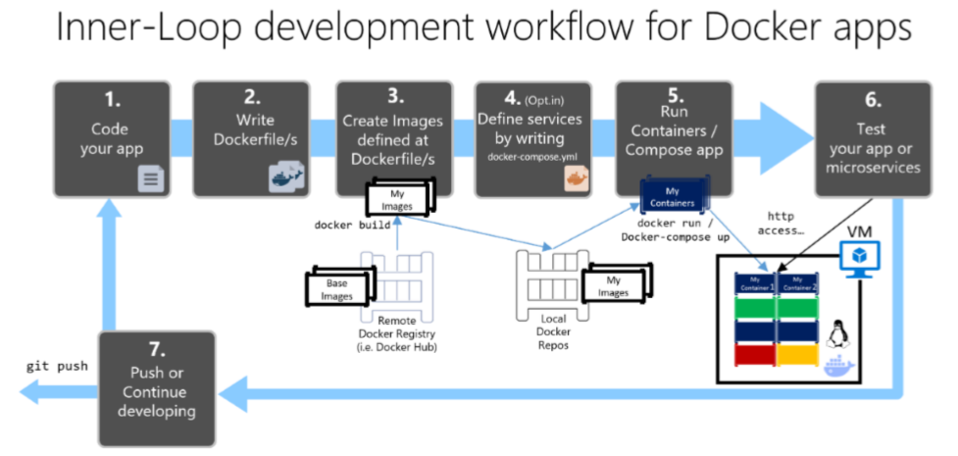
Development process

Slide 88
ORCHESTRATION

Slide 89
DEPLOYMENT
Each Docker container is a unit of deployment
A Docker host can handle multiple containers, but is not suitable for:
Load-balancing
Routing
Automatic Scaling
Automatic Startup and Shut-down
For large application with many microservices – we need clustering
And orchestration!
Usually available on public clouds
Kubernetes is an open-source product, solving the issue!

Slide 90
Verdict

Slide 91
The microservices Decision Tree
Are you Netflix?
Are you Amazon?
Do you have a worldwide scale and customers?
Do you expect a huge increase in your customer base soon?
Do you have a struggling with performance monolith?
Do you have the recourses to develop microservices?
If any of this is “Yes”, then do them!
It is always better to start with a monolith
And then extract microservices!
Also – make sure every team member is on the same page!

Slide 92
FINAL WORDS

Slide 93
Summary
Why Microservices?
Microservices Architecture
Data in Microservices
The Bounded Context
Logical VS Physical Architecture
Distributed Data Challenges
Identifying Boundaries
The API Gateway
Communication
Containers & Orchestration
Other Considerations
Avoiding Disasters

Slide 94
QUESTIONS?

